Slide 1
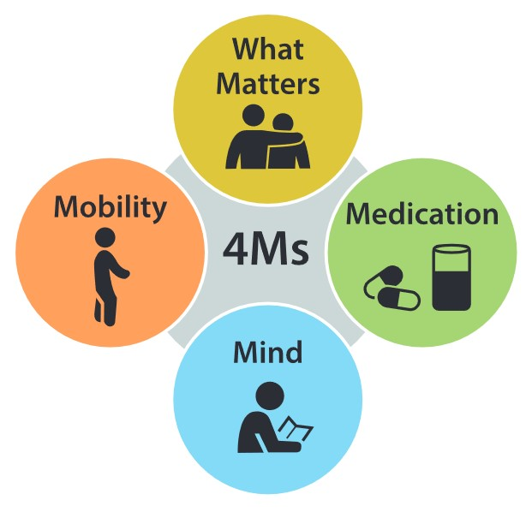
4Ms Training for Older Adults and Caregivers
Presenter Name
Presenter Organization
Date

Slide 2
Objectives
Identify the 4Ms: what Matters, Medication, Mind, and Mobility
Understand how the 4Ms can be used to inform conversations with providers
Brainstorm how to use the 4Ms by creating sample questions

Slide 4
What Matters
When you talk with your health providers, make sure the decisions make sense for you and your goals.

Slide 5
Medication
Bring all medicines with you to medical visits, or bring a list with the names and dosage of each medicine you take. Make sure each medicine is necessary. Be extra careful with high-risk medicines like painkillers.

Slide 6
Mind
Get screened every year starting at age 65 for dementia and depression. Bring up any concerns with your provider, such as changes in memory or loss of motivation to do things you like to do.

Slide 7
Mobility
Learn how to stay physically active. Check your home for rugs or missing handrails that can cause falls.

Slide 8
The 4Ms help you focus on your health and wellbeing.

Slide 9
Thank You!
If you have more questions, please contact:
Contact Name
Contact Phone Number
Contact Email Address

